Slide 1


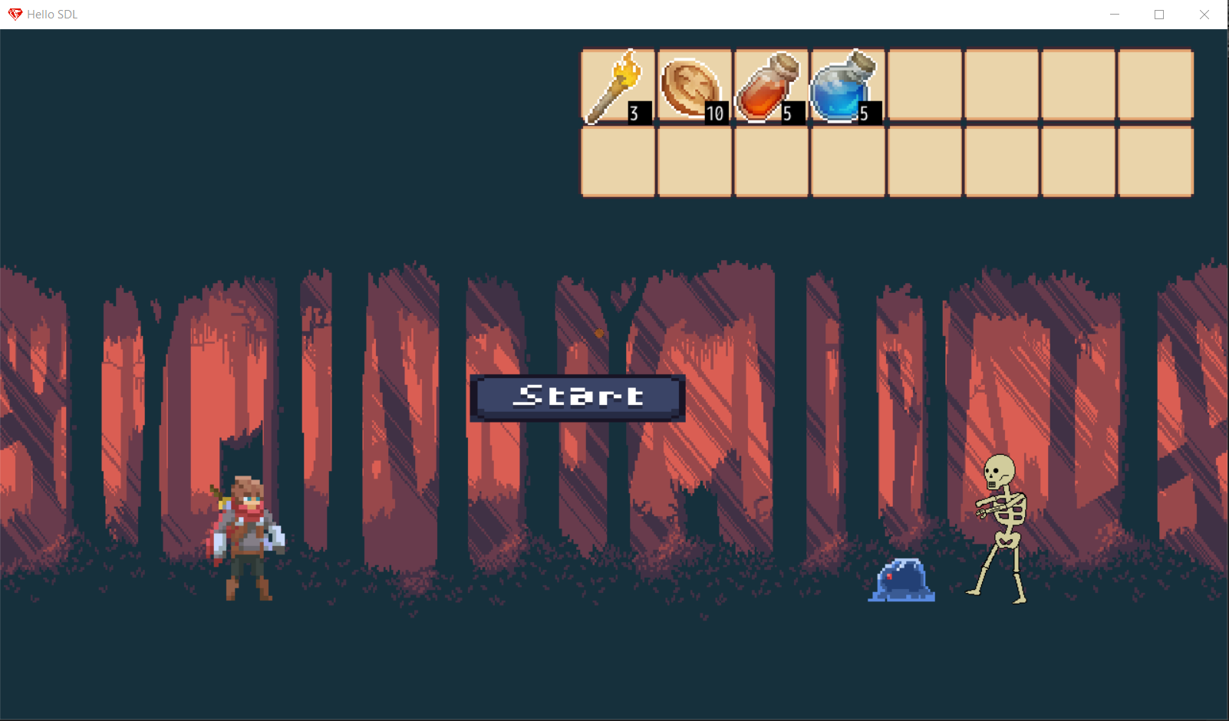
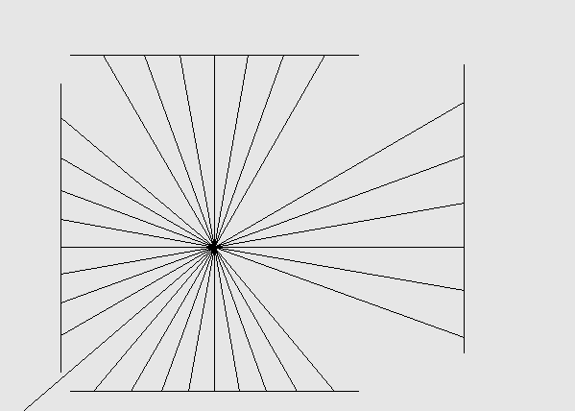
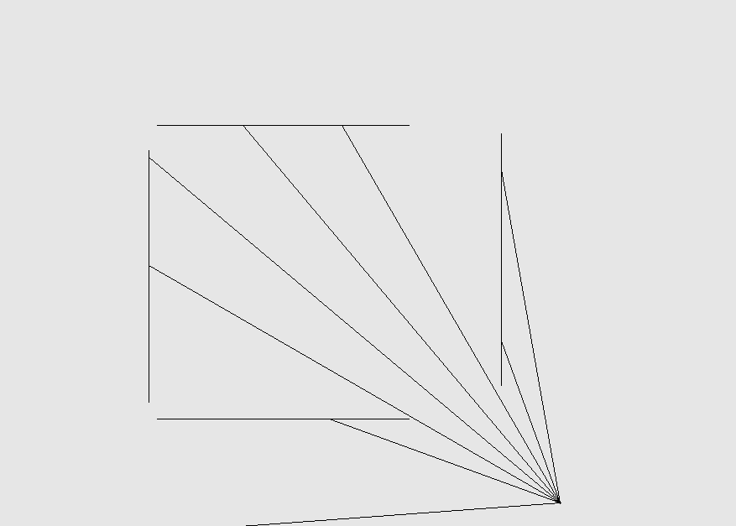
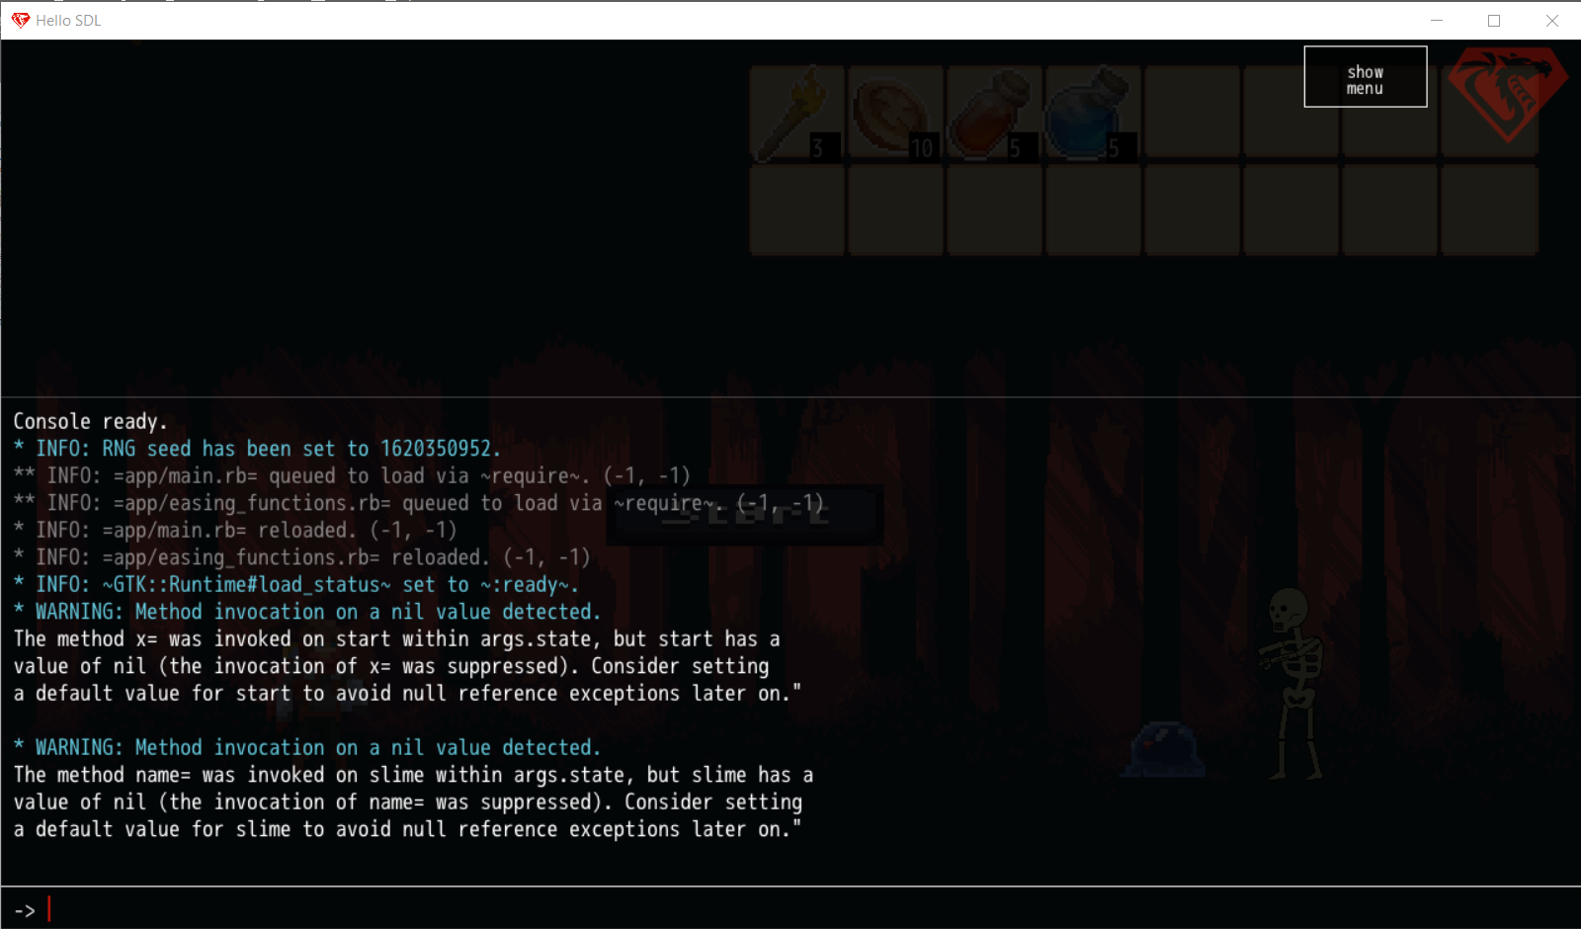
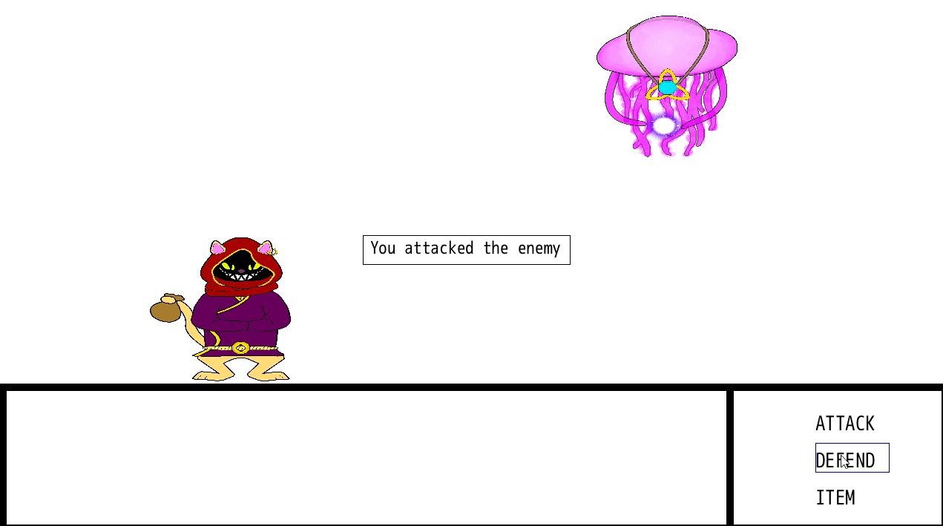
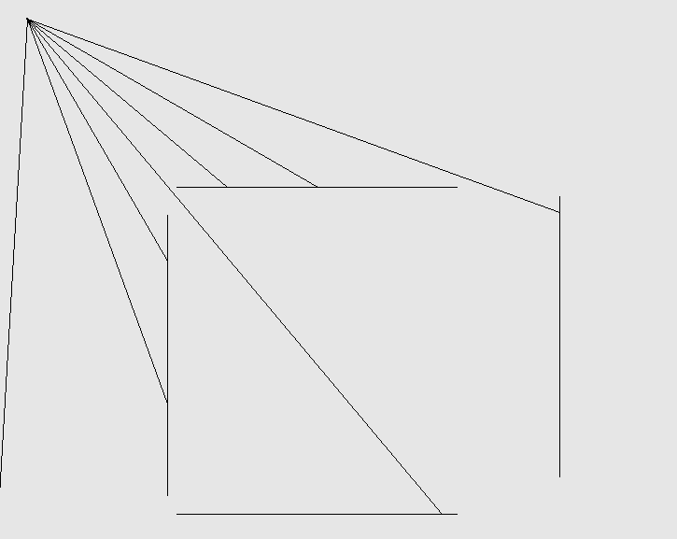
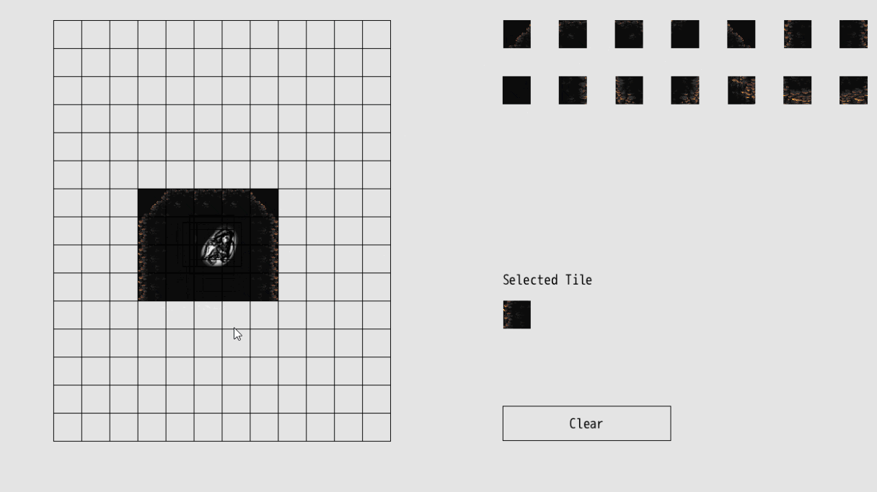
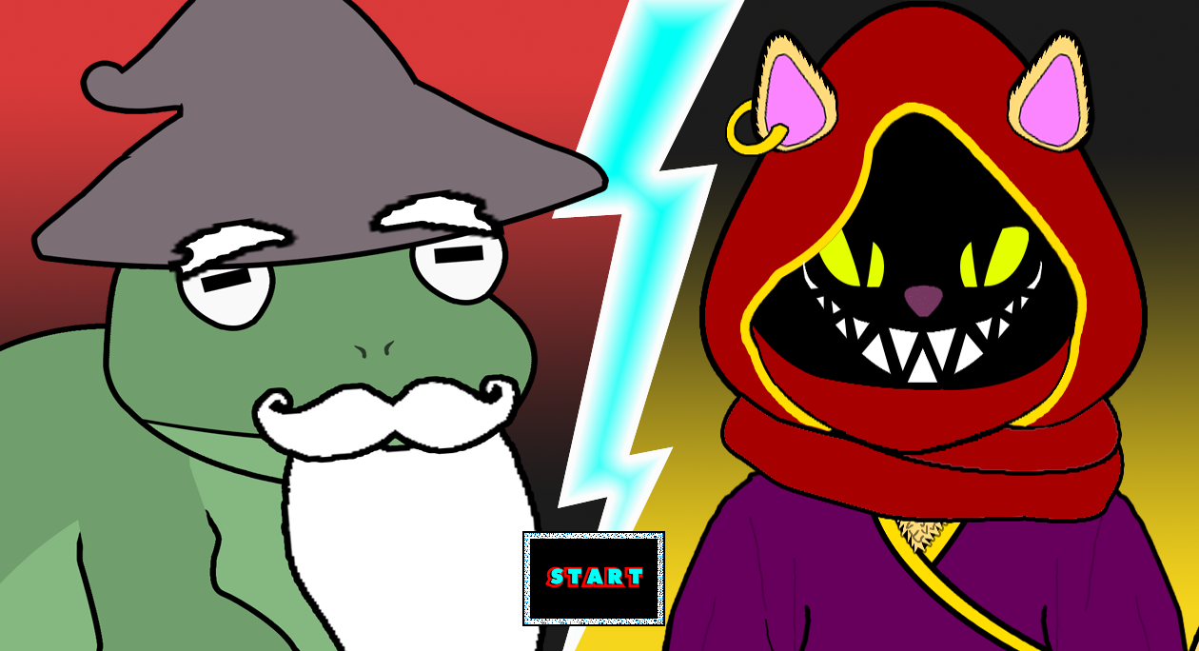
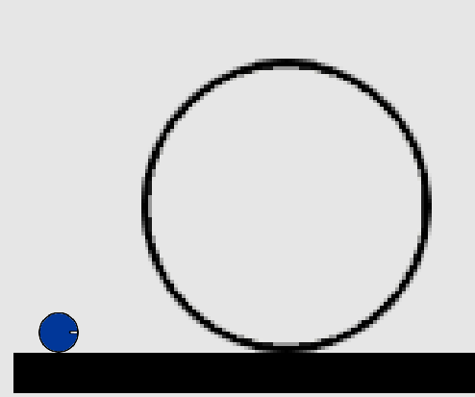
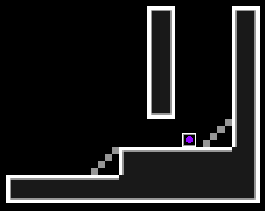
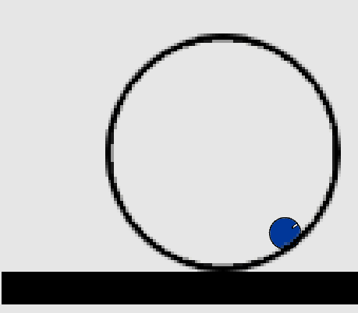
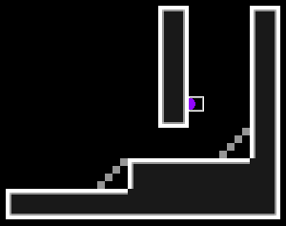
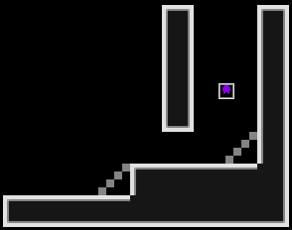
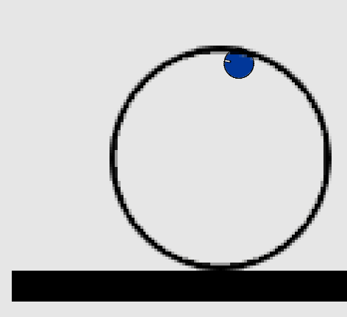
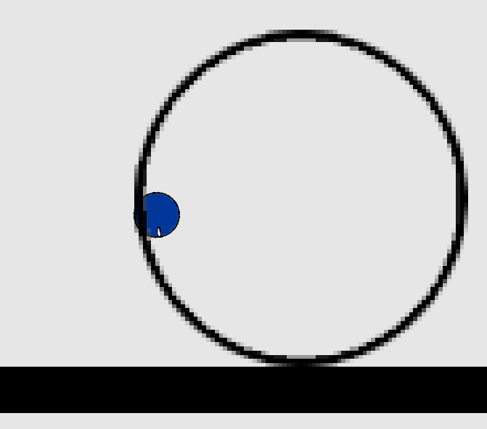
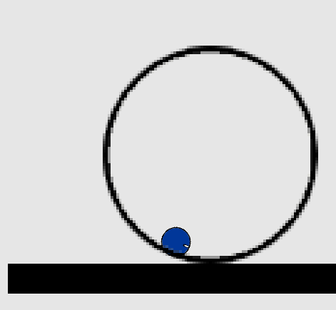
DragonRuby
Game Samples
Stephen Duffy, spd170330@utdallas.edu; Bowen Jiang, jxb170011@utdallas.edu; Nigel Lacewell, nll150030@utdallas.edu; Matthew Rachele, mor170030@utdallas.edu.edu; Jacob James, jrj170130@utdallas.edu;
CS 4485 / Spring 2021
Department of Computer Science
Erik Jonsson School of Engineering & Computer Science
The University of Texas at Dallas
Richardson, TX 75080, USA
DragonRuby
Abstract
Results
Shadow Casting Presentation Using Ray Casting
Creation of video game sample applications utilizing the DragonRuby Engine to display the functionality and features, as well as create new ones in the production of commercial video games made through the Engine. DragonRuby uses ruby as its native scripting language and acts as a display and console while in the process of editing. Our sample applications will be used to further the development of DragonRuby as an IDE and provide a backbone for future developers utilizing the platform.
Inventory Interact RPG with Screen Shake and Zoom
Keywords: Applications, Game Engine, DragonRuby
A Pokemon-like Battle Scene
Architecture
DragonRuby Engine
The DragonRuby Engine acts as a console or terminal overlay that is also a Ruby REPL. By saving a file as a .rb and running it using a batch file, the DragonRuby console displays the current results.
2. A Pokemon-like Battle Scene
A Map Editor
Impact
Dragonruby has benefitted from project functions pushing the limits of the engine
Users of the Dragonruby engine can examine new physics simulating functions through sample apps
Users of the Dragonruby engine can examine visual effects in through sample apps
Sonic-like Loop
Performance
Simple Platformer with Walljumping
Able to calculate physics for looping and wall jumping
Able to create a map editor
Able to implement background parallax, easing, screen shake, and zoom
Able to implement ray casting to add shadow casting to the engine
Summary
These templates provide some features that DragonRuby didn't have before.
Beginners will find it easier to make similar games by using these templates.
DragonRuby provides easy access to beginner-friendly cross-platform 2D game development.

